Slide 1
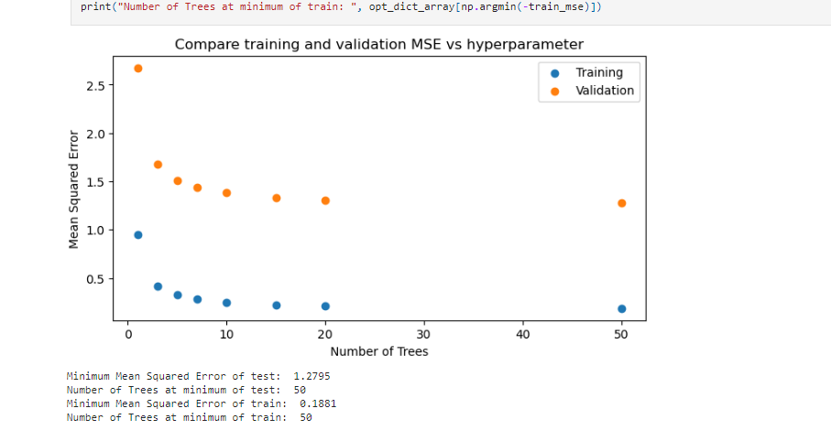
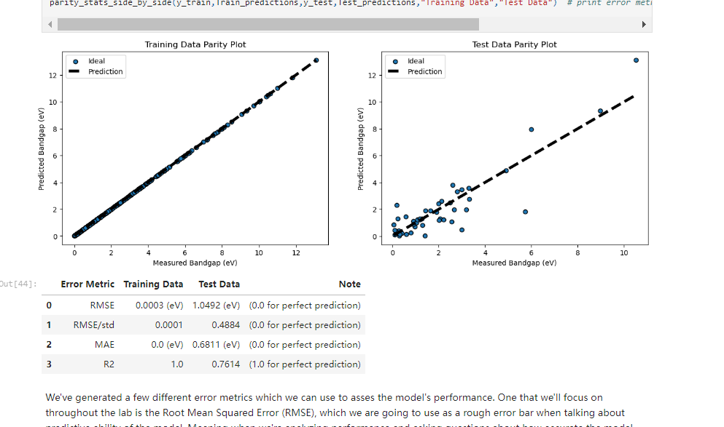
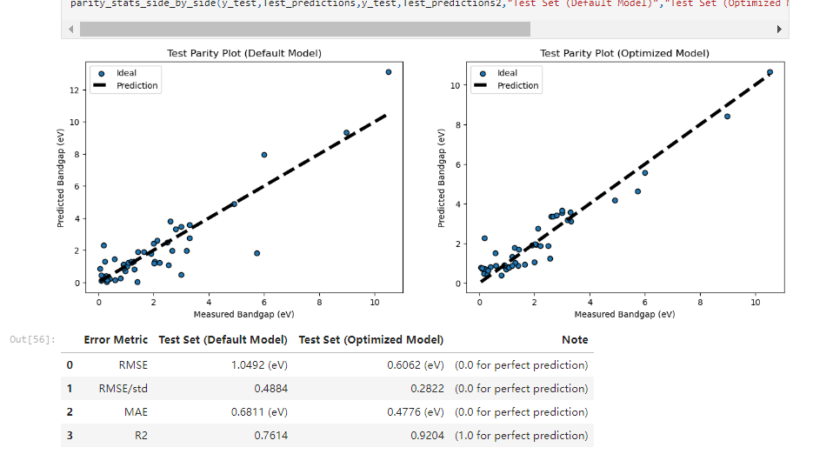
Assessment Figures

Slide 2
ML4ER Assignment 3
Jiahui Yang
Informatics Skunkworks
MSE 401, 3 Credits
Jul 24 2024

Slide 3
Progress
Default model test data parity plot from above exercise 5.1
Training Data Parity Plot: Data points align closely with the ideal dashed line. Test Data Parity Plot: Data points are more scattered compared to the training plot, indicating prediction errors.

Slide 4
Progress
Learning curve plot from above exercise 6.1
MSE decreases as the number of trees increases, with training error consistently lower than validation error.

Slide 5
Progress
Test Parity Plot (Default Model): Data points scatter around the ideal dashed line, with noticeable deviations. Test Parity Plot (Optimized Model): Data points align more closely to the ideal dashed line, indicating improved predictions.
Optimized model test data parity plot from exercise 6.4

Slide 6
Problems
I have no problems with the sections I need to go through this week.

Slide 7
Questions
Could you recommend any detailed textbooks on machine learning algorithms? I understand the working principles of most ML models but would like to delve deeper into the specifics.

Slide 8
Hours Summary
Date | Hours | Description of Work
07/24/2024 | 1.0 hours | Complete through section 7 of module 1

